Slide 1

Nielsen – Store Transaction Imputation

Slide 2
Team Name: Dfyunli
No of team members: 1
Team Members: Aakash Singh

Slide 3
Problem Addressed:
Data received from many stores monthly through POS machines or manually.
Although data collected is incomplete, there can be many facts like:
A transaction involving a single packet of chips or a single piece of candy may not be scanned.
During rush hours when the store is crowded with customers.
Basically it is observed that certain stores do not share data for all active days. Stores share data ranging from 2 to 28 days in a month.

Slide 4
Approach adopted to solve the problem:
Imputation/extrapolation technique for not collected samples from various days in a month can be:
Examining which GRP of items is sold highly on which store on what day.
Counting day wise samples frequency for particular STORE and MONTH i.e. on which day how much billing gets done so we can impute for next or previous missed days.
Filling missed days with high occurred GRP in store and month wise.

Slide 5
Explanation of the solution:
Predicted price for samples having 0 price with help of other sample based on same GRP, MBRD and STORECODE.
Visualized the no. of days from all stores from all months on samples were not collected using bar graph.
Created a function to calculate top sale of GRP, store and month wise.
Sale frequency count for different days of particular month and store, took mean frequency which will be imputation frequency to missed days.
e.g. 115 was the avg sale frequency from month M1 and store N1 so for all missed days, 115 times we will extrapolate and find the VALUE, GRP for each.
Similarly count the VALUE and GRP for each missed samples.
Appended this imputed dataframe to our dataframe and calculate TOTAL_VALUE for each IDs.

Slide 6
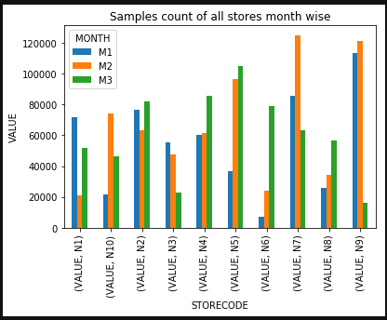
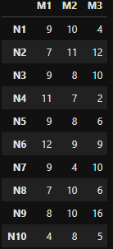
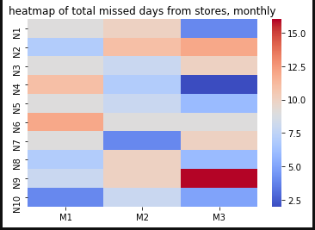
Screenshots of the solution: Total missed days from different stores

Slide 7
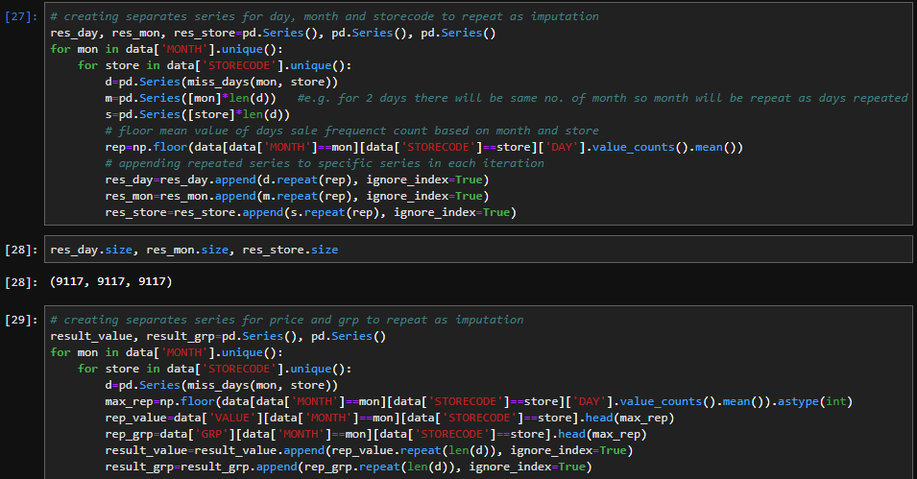
Screenshots (cont..)

Slide 8
Thank You!

